Slide 1
6 Rooks
Deb Jyoti Ghosh
Global Intern Hackathon 2020

Slide 2



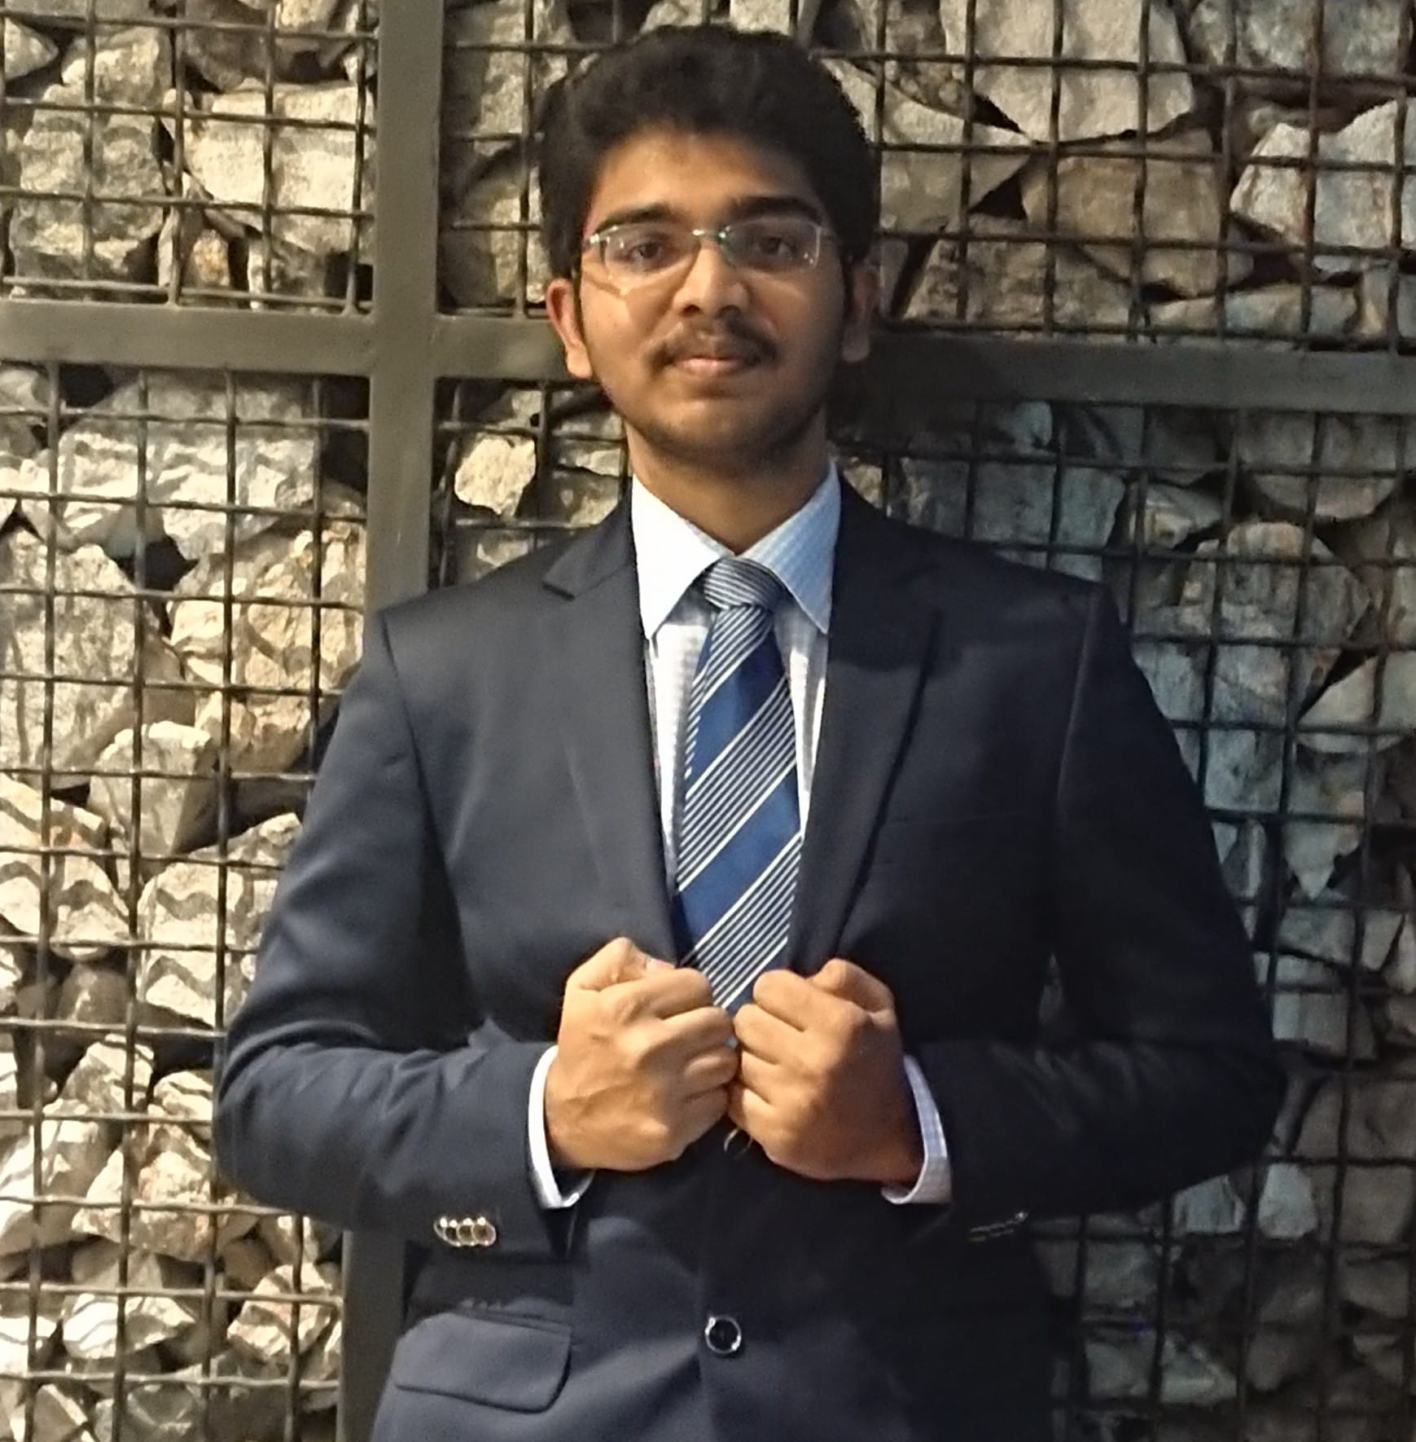


6 Rooks, IIIT Hyderabad
Backend team
Upinder Singh
Manik Gupta
Pradeep Pallikila
Frontend team
Vijayraj Shanmugaraj
Shreyas Nagaraj
Shanu Gandhi

Slide 3
Visa Experience
Theme Chosen: Visa Cardholders
Value-added-service for Visa cardholders
Target Segment: Affluent Cardholders who value seamless experience.
Very convenient and seamless way to avail and pay for a variety of services
Restaurant reservation
Spa reservation
Sports activities and much more

Slide 4
Idea relevance in COVID situation
Promotes cashless transactions
Service providers
Helps reduce crowd density
Manage resources better
End users
Choose places based on number of reservations
Reduce queueing time

Slide 5
Demo (https://youtu.be/2n5DOov-0Qg)

Slide 6



Technology Stack
Front End Technologies used:
React Native for application development
Uber Developers API
Expo Framework

Slide 7



Technology Stack
Backup Technologies used:
Django Framework & Django Rest API Framework
Postgres SQL DB
Heroku PAAS

Slide 8
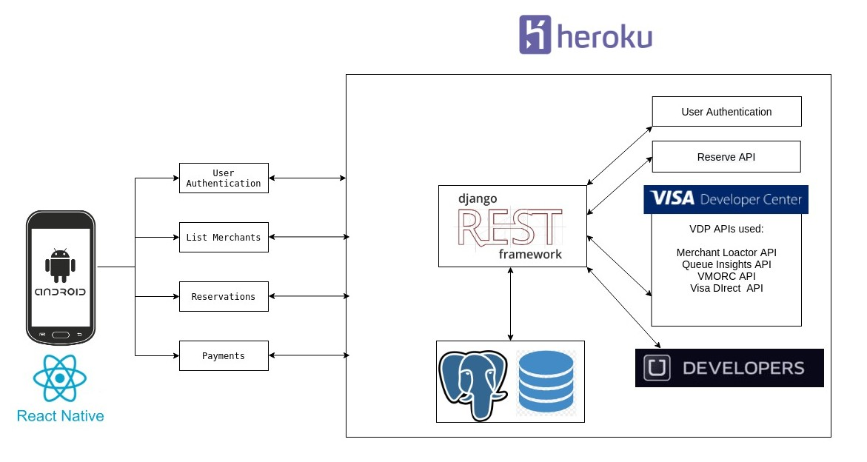
Application Architecture

Slide 9
Challenges faced
Remote working
Time constraint
Learning new technologies
Learnings from the hackathon
Tech behind e-payments
Importance of Agile methodology
Significance of Developer community
React Native, Django, VDP

Slide 10
Future Scope
Customized offers based on user preferences
Display number of reservations made for each service-provider at user end

Slide 11
Thank you!

Slide 12
Timeline
 | Duration | Tasks
Ideation Phase | 12 June - 17 June | Brainstorming on ideas Vote among top ideas
Sprint 1 | 18 June - 21 June | Skeleton App User Authentication User Register Fetch nearby restaurants
Sprint 2 | 22 June - 26 June | Uber integration VDP integration UI enhancement
Sprint 3 | 27 June - 1 July | Integration Testing Bug fixes Improvements based on feedback

Slide 13
Front –End Technical Decisions:
Why React Native
React Native vs Flutter vs Native Android
JavaScript vs Dart
Developer community & diverse set of libraries
Expo
Easier to run, test and deploy
Source: Add your source here.

Slide 14
Back–End Technical Decisions:
Why Django?
Development time is significantly reduced
ORM(Object relational Mapper) out of the box
Follows MVT design Pattern (similar to MVC Design pattern)
Why Heroku?
Platform as a Service (PaaS)
Easy deployment
DB management
Scalability
In demand scaling with increase in load
horizontal and vertical scaling

